Slide 1
Urban Marine Pollution
5/XX/2024

Slide 2


Shreya
Trevor
Stephanie
Tianxiao
Xiaofan
The Team

Slide 3
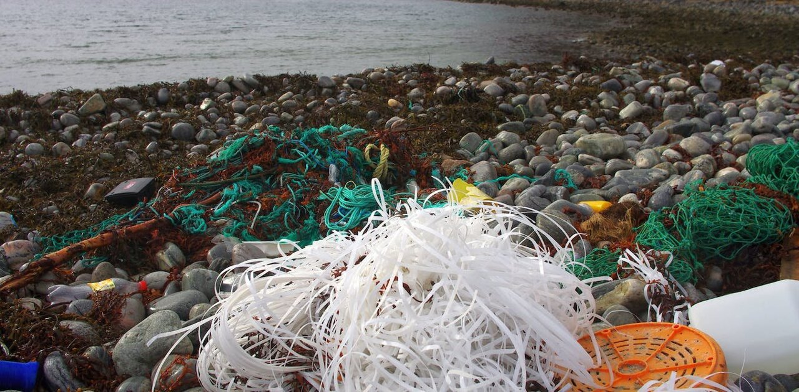
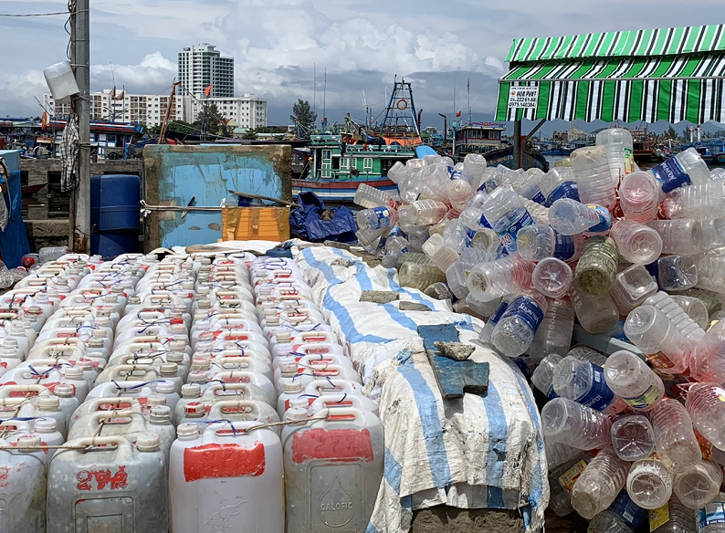
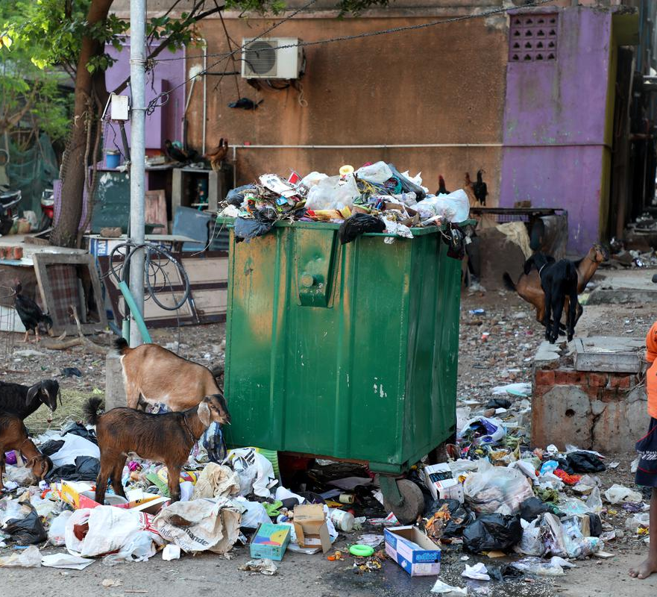
Plastics by the Numbers
11 million tons of plastic end up in the ocean
Poisons marine life, 60% of examined fish digested microplastic
Illegal dumping, lack of sanitation infrastructure, single-use plastic

Slide 4



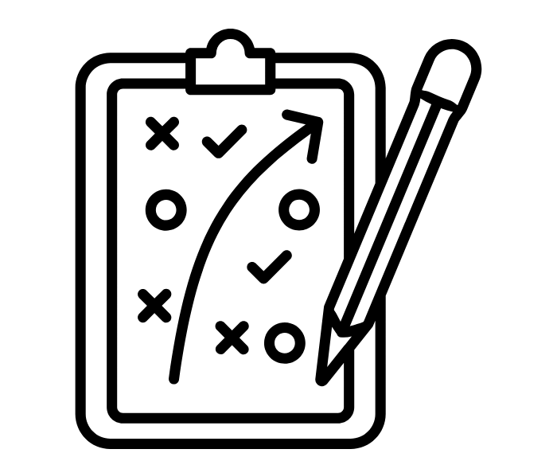



Ocean Conservancy’s Urban Ocean Program
Assessing each city’s sanitation on case-by-case
Strategy Planning for waste reduction
Develop scalable site selection to identify most urgent areas to focus on

Slide 5
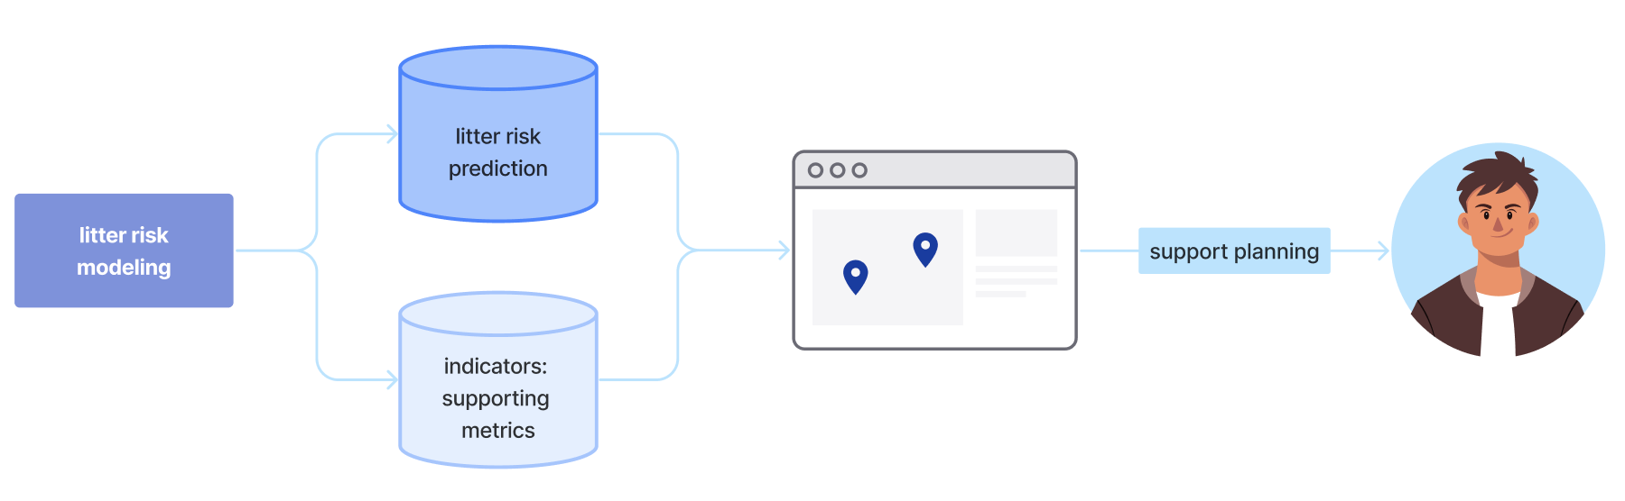
Use Case
A web-based dashboard with litter data metrics, demographic metrics, and a litter accumulation risk site-selection tool serving the 12 cities of the Resilient Cities Network in siting zero-waste pilots.

Slide 6
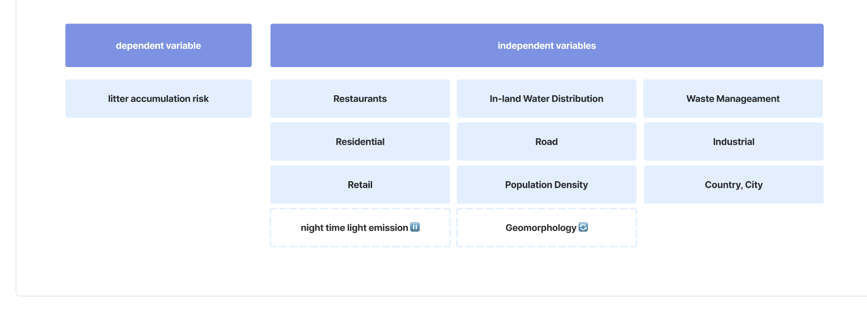
Variables
Notes:
Number of observations per pixel = zoning + commercial activity + proximity to water

Slide 7
Formatting & Data Visualized

Slide 8
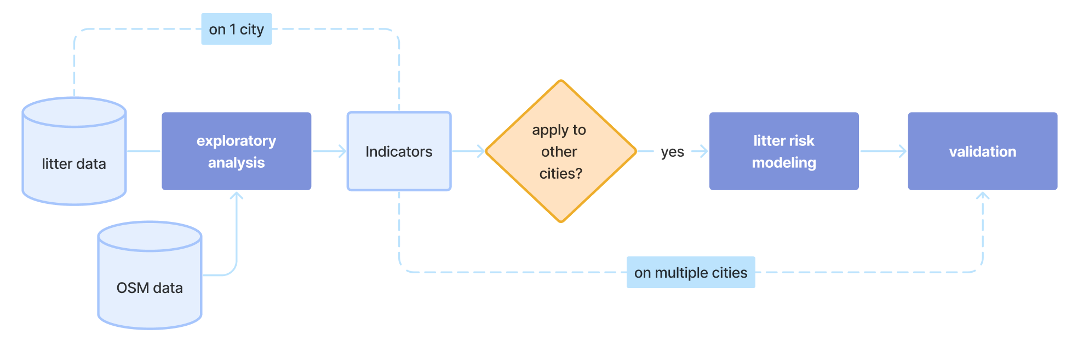
Modelling Process

Slide 9
